Slide 1

Screen Shots
V 0.1
April 7, 2004
CONFIDENTIAL
Notes:
There are 10 key functional screens to be designed and implemented. They have variable information that comes from numerous sources. The notes that follow talk a bit about the function of the screens and the nature of the data.
The use case that’s described is:
Patient orders a copy for a second opinion by Dr. Smith
The logo on the slide is temporary as are all of the design elements on these slides. Let your imagination run wild.

Slide 2
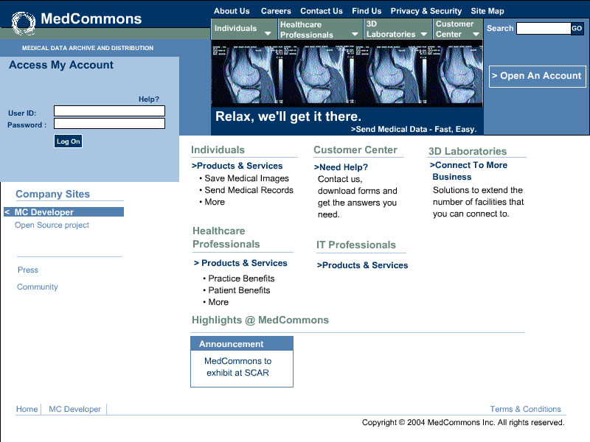
www.MedCommons.net
Notes:
This is the home page of MedCommons at www.medcommons.net.
The userid and password should not travel in the clear.
Search should accept a Tracking Number
Open an Account takes us to the next screen.

Slide 3
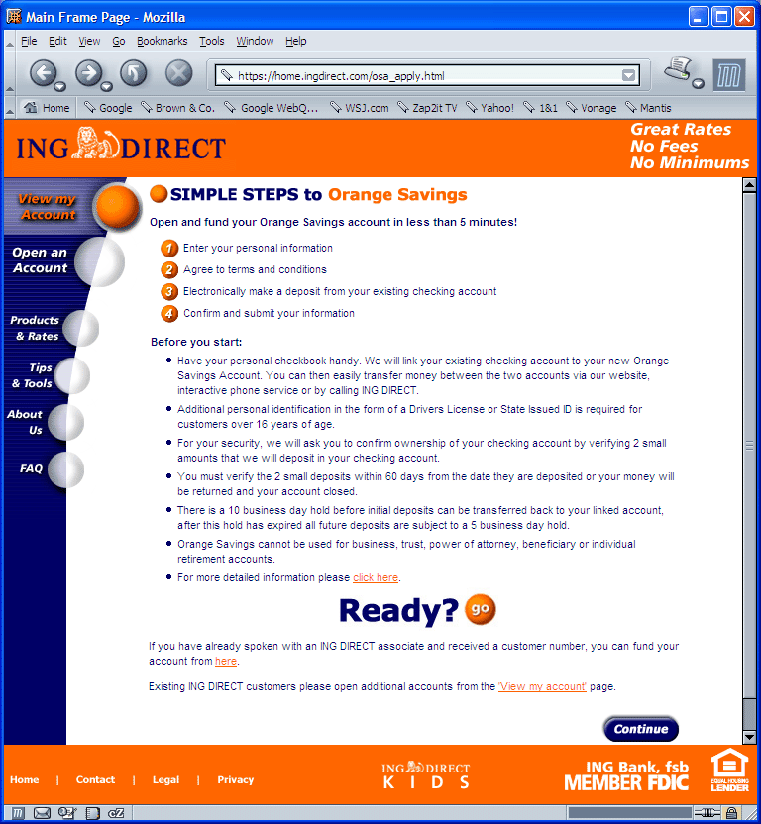
Terms of Service
Notes:
This is typical of a serious legal contract with a user.
This screen and the Account Info screen will be different for:
A Patient;
A Physician;
A Facility that installs the software on a DICOM network;
A Developer or Administrator that will customize forms, recipes or manage multiple accounts.
It tells you what you can expect from the service.
It reassures you by using a mechanism to reduce the risk of identity theft.
This screen is not “active” in the strict sense of the term but the software that implements the authentication will need to be done.
It does it all in one page without a scroll bar (on a Tablet :-)

Slide 4
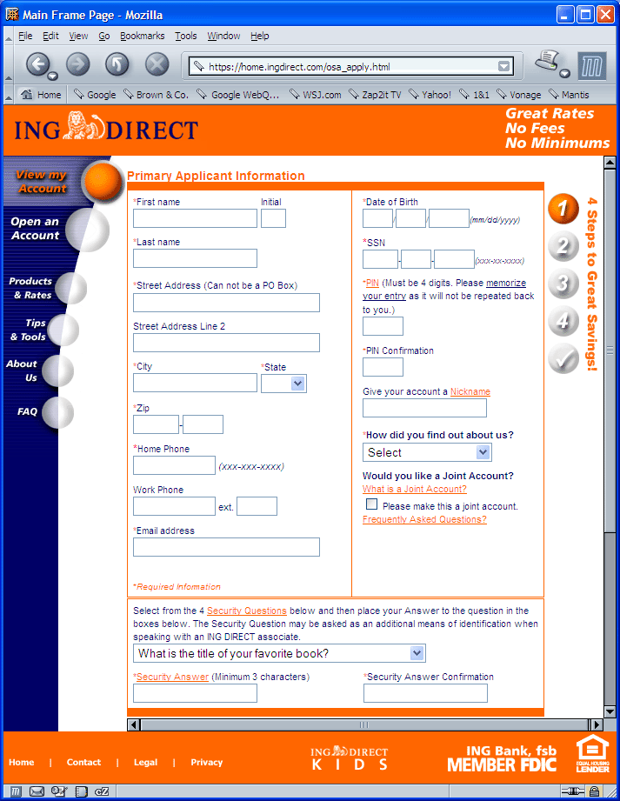
Account Information
Notes:
Here’s where we issue a password and deal with recovery of a lost password.
Credit Card information will need to be captured in some cases.

Slide 5
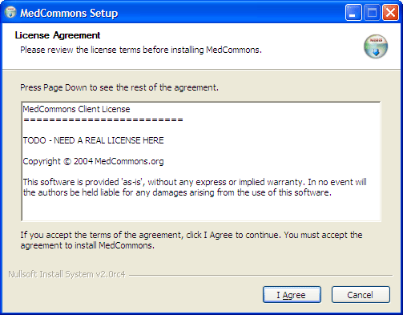
Installer
Notes:
If registration allows software installation, the installer can be downloaded and run.
The licensing Terms will need a lot of work.
Open source components will be credited and the source will be posted on our web site.

Slide 6
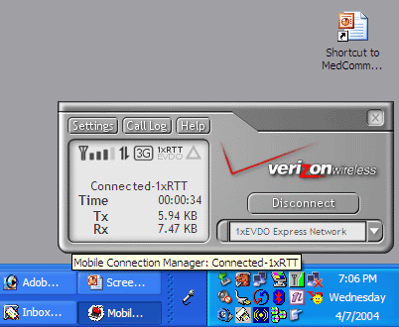
Router Monitor
Notes:
Installation of the Router is associated with a system tray app (arrow) that has three states
Gray – Software installed but router is not running
Green – Router is running
Red – Router has problems
Mousing over tells you a bit more info before you actually have to open the window.
The Settings button should
Allow entry of DICOM AETITLE and IP address for up to 5 LAN destinations
Allow authentication of the Facility (this router) to medcommons central
The drop-down list could let users choose which Router they use as their default Router if more than one is available
The status window should give indication of recent activity without divulging any patient identifiable info.
The Log button should also protect patient privacy.

Slide 7
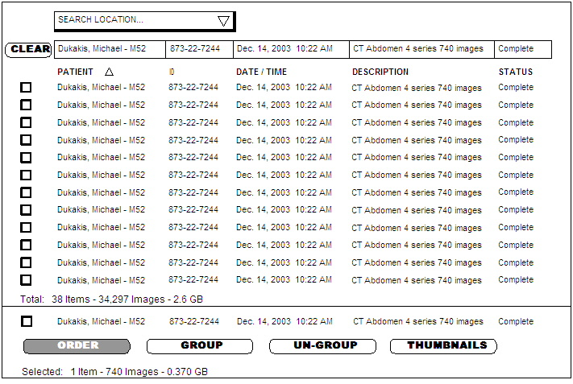
Selection Screen
Notes:
The Selection Screen is a user dependent list of
DICOM Studies
Orders that may not have images yet
MedCommons Order Forms that are incomplete or have problems
Folders that represent collections (usually copies) of the above.
The Selection Screen can point to:
The Router that is currently the Default Router
Another Router that is accessible securely – such as at the Hospital, from home
A DICOM device listed in Settings on the Monitor (previous slide)
The User’s account on medcommons central
The Selection screen can be:
Full featured and updated every second or so
A Webtop that works along with the WADO Viewer with no install PCs and Macs
Absent – When CCOW is available, the selection screen of the EMR or workstation will send info directly to the Order Form

Slide 8
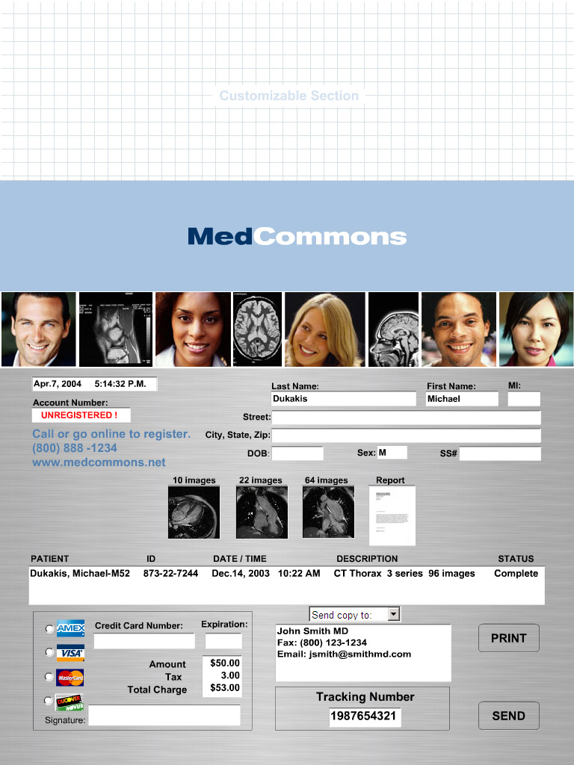
Order Form
Notes:
The Order Form is selected
Implicitly by some automated default
Picked from a list on the selection screen
Picked from a menu if the selection screen has been bypassed by CCOW
Any typing into the Selection Screen is a minor tragedy. Most of the information should be extracted from DICOM, a credit card, linked in from a profile on medcommons, picked from a list.
Some parts of the Order Form will need to be obscured in some cases.
Credit card info
Some patient information that we don’t interpret but the hospital puts on for a lab’s convenience.
The thumbnails are important for quality control purposes. If their resolution is not sufficient, then clicking on them launches the WADO Viewer.
The report also has a thumbnail and is readable in the WADO Viewer or otherwise.

Slide 9
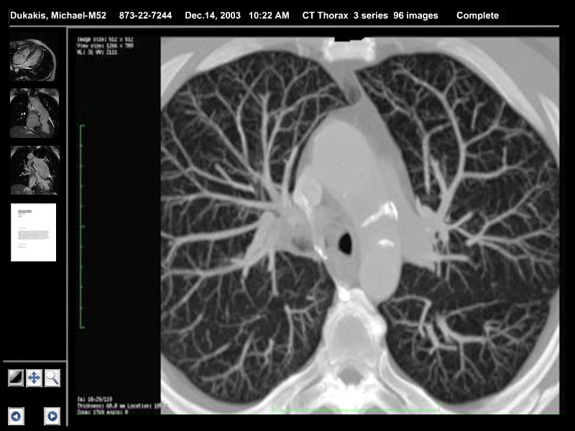
WADO Viewer
Notes:
The WADO Viewer has essential tools only (lower left corner) but is very fast.
The thumbnails match the Order Form but are vertical on landscape displays because most images are square.
There are many image types to worry about (someday) see the nice display at http://homepage.mac.com/rossetantoine/osirix/ for a sampler.

Slide 10
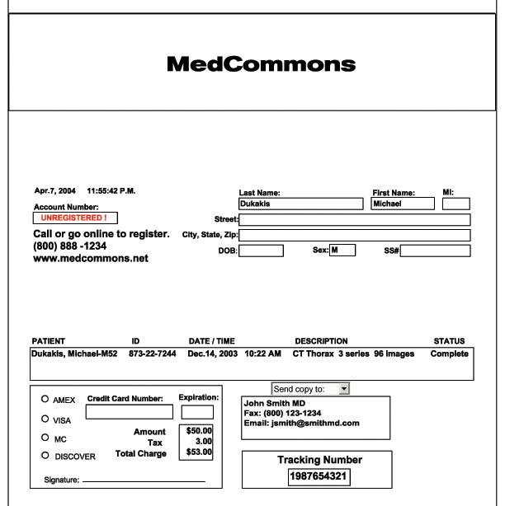
Printed Receipt
Notes:
Finally, patients may need to be given a receipt for their virtual transaction. A printed copy of the Order Form is nice but a slip from a credit card printer may be sufficient.

Slide 11
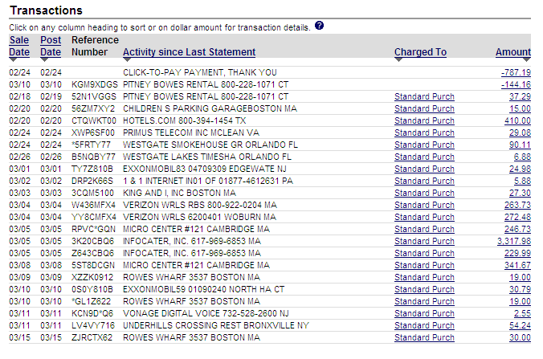
HIPAA Log
Notes:
The HIPAA Log is always available at the central facility.
The log is kept for a user and for a facility based on their profile information.
All studies that are accessed by anyone outside of MedCommons staff must be logged.
MedCommons support staff can be lagged as above or will be covered by different rules TBD.

